Slide 1
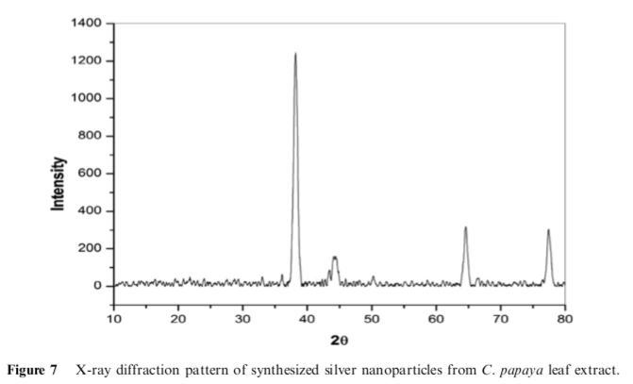
Green synthesis and characterization of Carica papaya leaf extract coated silver nanoparticles through X-ray diffraction, electron microscopy and evaluation of bactericidal properties
The biosynthesis of nanoparticles was done using micro- bial strains, enzymes and metabolites, plant extracts and biodegradable products. Biosynthe- sis of nanoparticles by using C. papaya fruit and leaf extract had been previously reported to be having antimicrobial properties.
X-ray diffraction analysis of silver nanoparticles. X-ray diffraction measurements of biologically reduced silver-nitrate solution drop coated onto glass slides were determined by an X’Pert Pro P Analytical X-ray diffractometer instrument with Xan’Pde high score plus software operating at a voltage of 40 kV and a current of 30 mA with Cu K a radiation. The scanning of biosynthesized silver nanoparticles is exercised in 2h region and the data are analysed. The Debye–Scherrer equation was employed to calculate the average particle size of the CPL-AgNPs.
Results
XRD data show diffraction peaks at 2h = 38.2°, 44.4°, 64.6°, 77.5°, and can be indexed to (1 1 1), (200), (220), (311), and (222) planes of pure silver ions indicating the biosynthesis of silver nanoparticles

